Slide 1

Development of IoT Based Smart Healthcare Monitoring System
1807228 Souvik Karmakar
1807274 Indrashis Mitra
1807277 Kinjal Sarkar
1807291 Pratyay Basu
Guided by :-
Dr. K.B.Ray

Slide 2
What is it?
It is an effort to engineer an affordable, remote, yet accurate IoT Health Monitoring system using sensors, modules and cloud IOT platform
Objectives :
To monitor patient parameters (pulse and temp).
To develop a fault alert system for aged patients,that will help to alert necessary people in case of an emergency

Slide 3
A short Description about our project:-
Objective 1:-(Monitor patient parameters remotely to increase efficiency of healthcare management systems)
The main objective of this project is to develop, design and implement a smart patient healthcare monitoring system.
The sensors used here are embedded in the body of the patient to sense the parameters like the heartbeat and temperature. These sensors are connected to a master unit, that calculates the values of all of them.
These values are then transmitted by leveraging IoT cloud technology, to the base . From the base station, these can be easily accessed by the doctor present at some other location. Thus based on the temperature and pulse values, the doctor can decide the state of the patient and appropriate measures can be taken.
Objective 2:-(Development of a Wearable-Sensor-Based Fall Detection System for the aged people.)
To recognize a fall from normal daily activities by using sensors, and automatically sends a request or an alert for help to the caregivers so that they can pick up the patient.
For sending messages to the caregivers in this project we are using IFTTT (If This Then That)integration ,it is a web-based service by which chains of conditional statements, called applets can be created. Using these applets, we can send Emails, post on Twitter, play music, exchange SMS, receive and send notifications, etc. The purpose of using IFTTT in this project is to send SMS notifications to the mobile phone when the system detects a fall.

Slide 4
Materials
Required
Temperature Sensor - MLX 90614
Pulse rate sensor - MAX 30102
MPU 6050 Accelerometer and Gyroscope Module.
Strap
Battery Case
4-Bit 7-Segment 0.56" Red LED Digital Display Tube For DIY or Arduino
Connecting Wires
Casing
Panasonic CR2032 3V Li Coin battery - 5
Nodemcu Wi-Fi Dev. board
GSM Module: UBLOX NEO 6M Gps

Slide 5
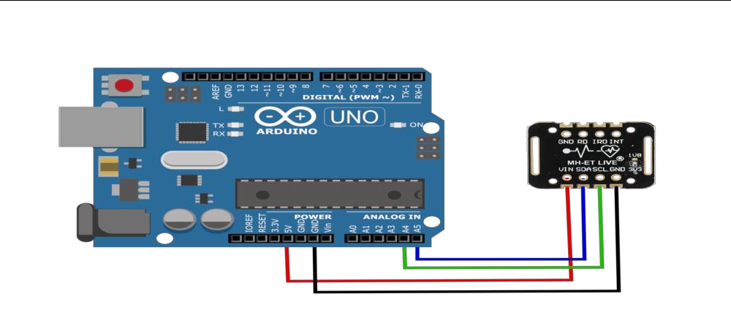
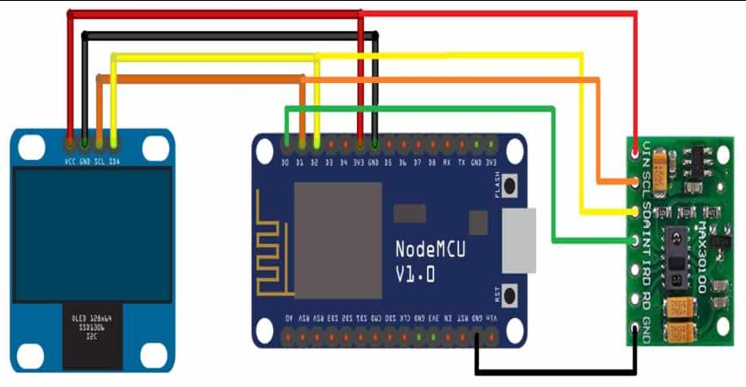
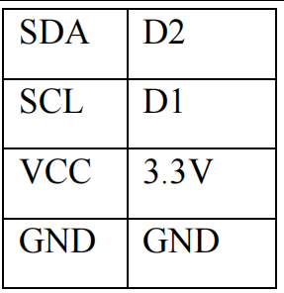
Arduino UNO and Nodemcu interfacing with MAX 30102

Slide 6
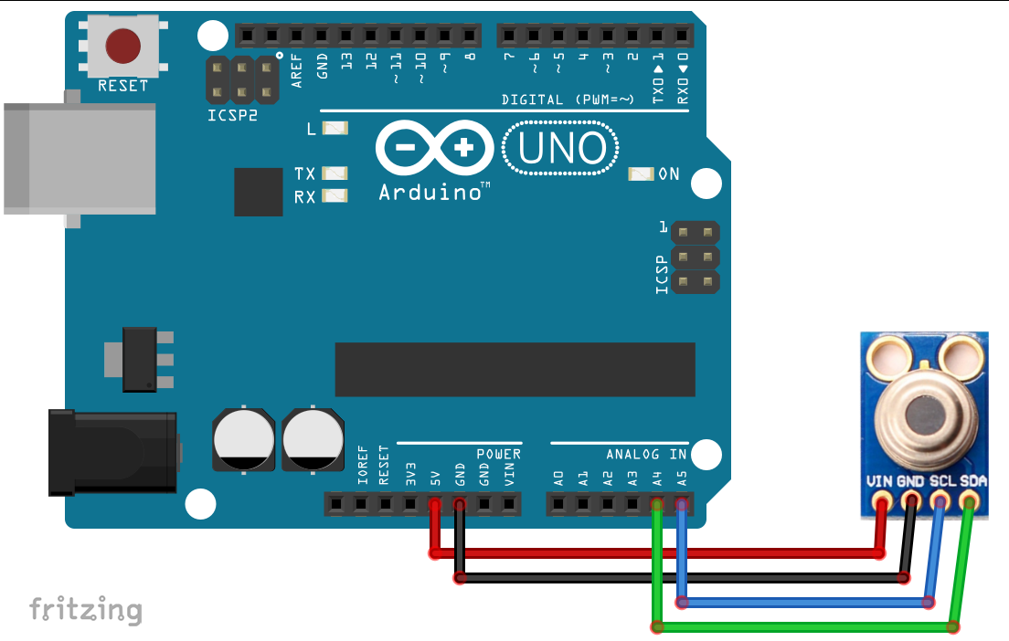
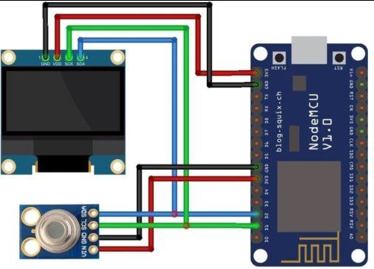
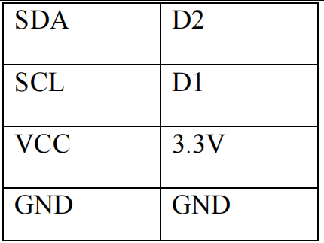
Arduino UNO and Nodemcu interfacing with MLX 90614

Slide 7
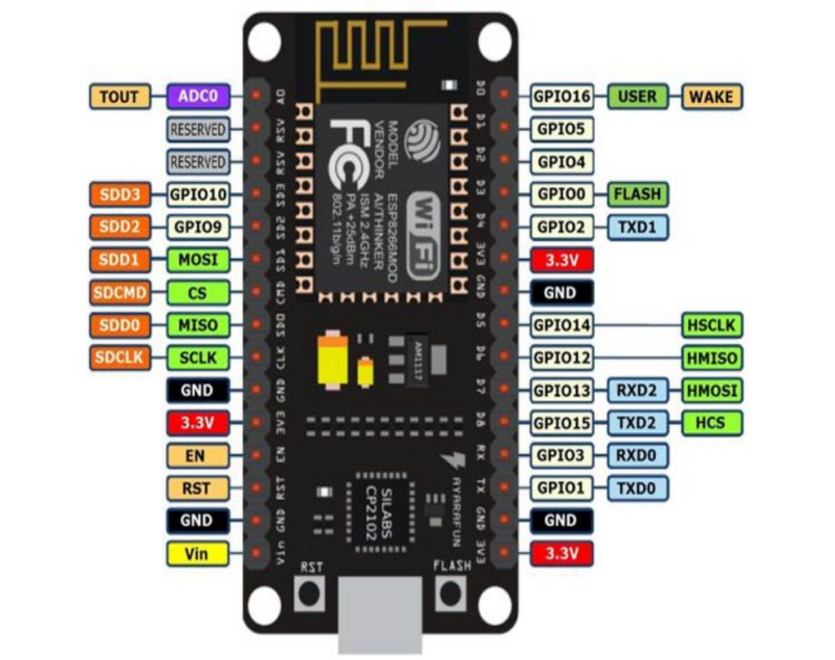
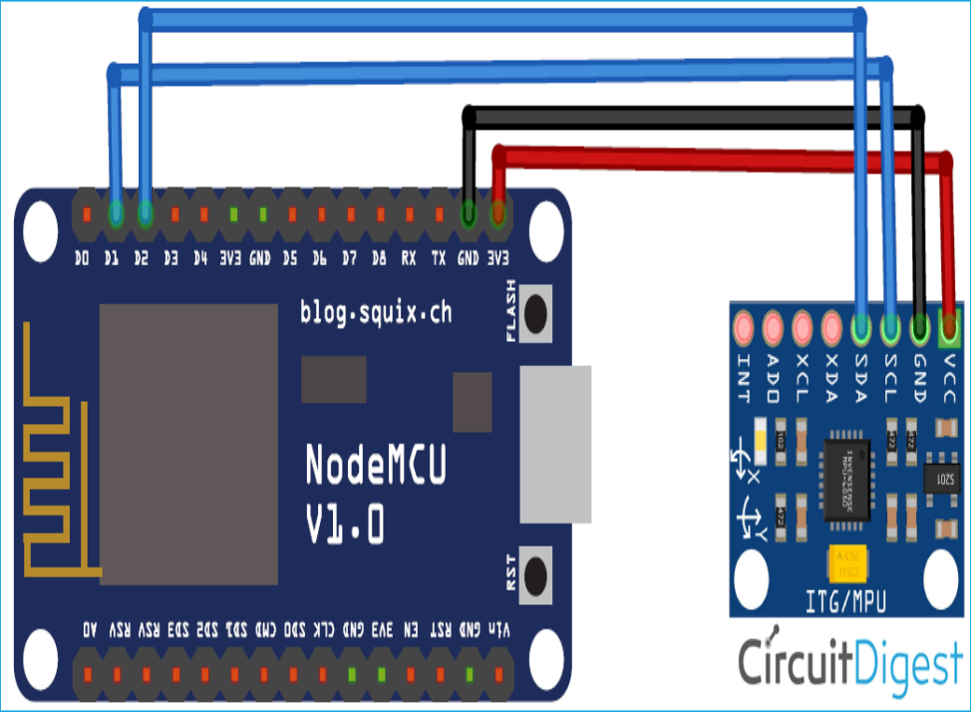
Nodemcu interfacing with MPU6050
Pinout configuration of Nodemcu

Slide 8
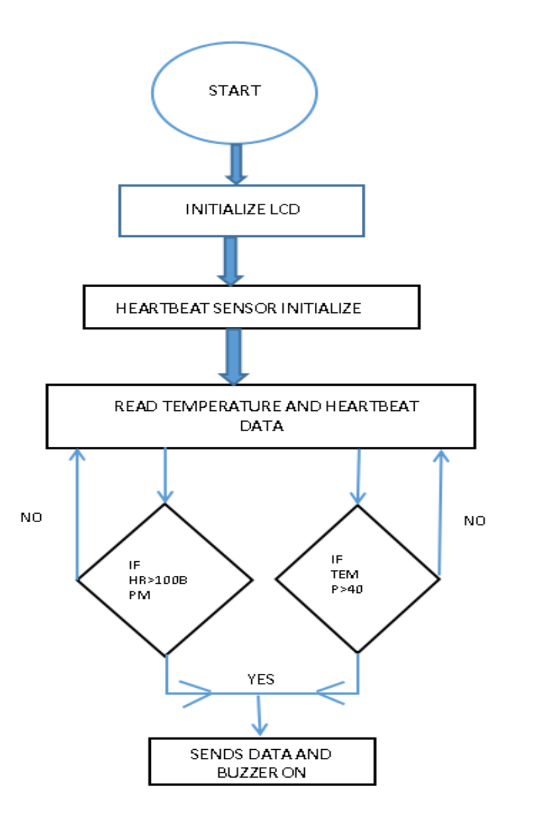
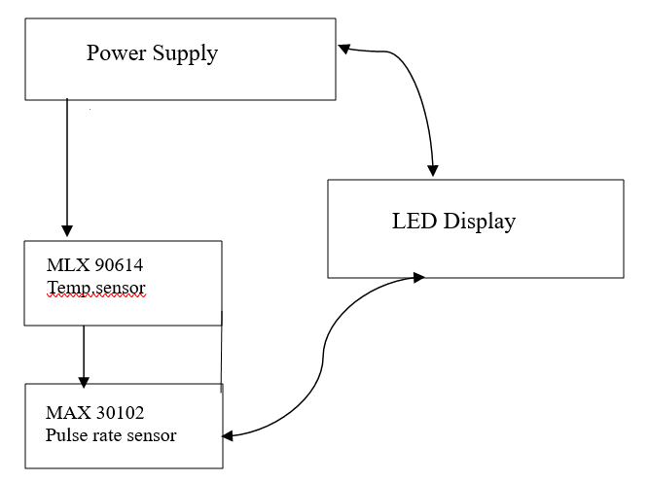
Flowchart and Block Diagram for patients parameters monitoring

Slide 9
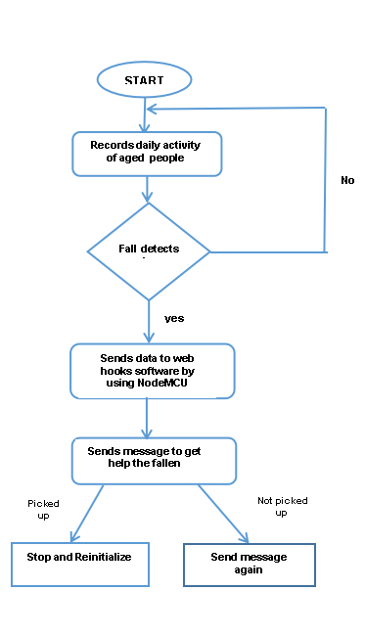
Flow diagram for Fall detection system

Slide 10
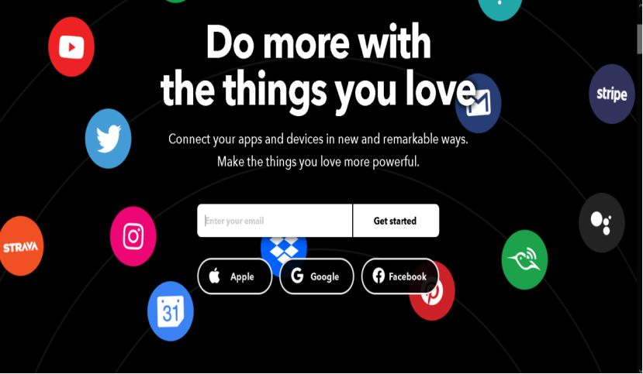
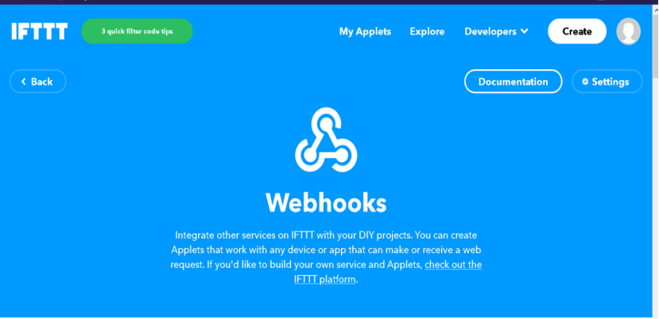
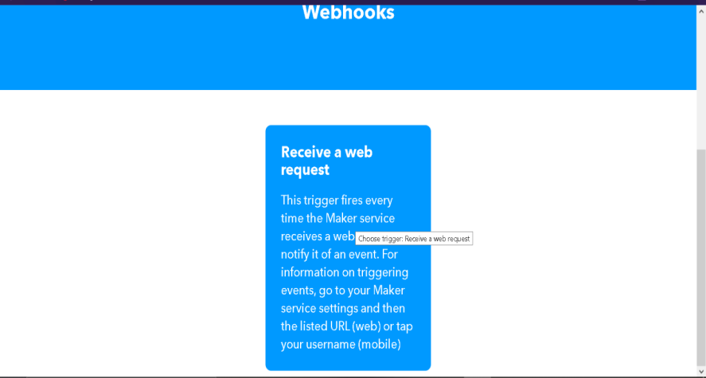
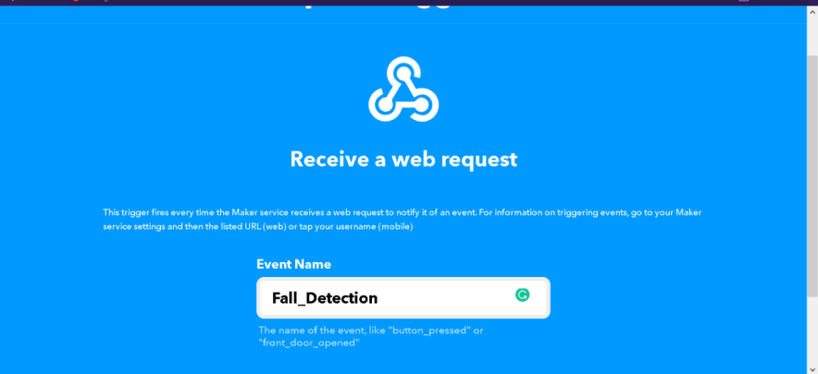
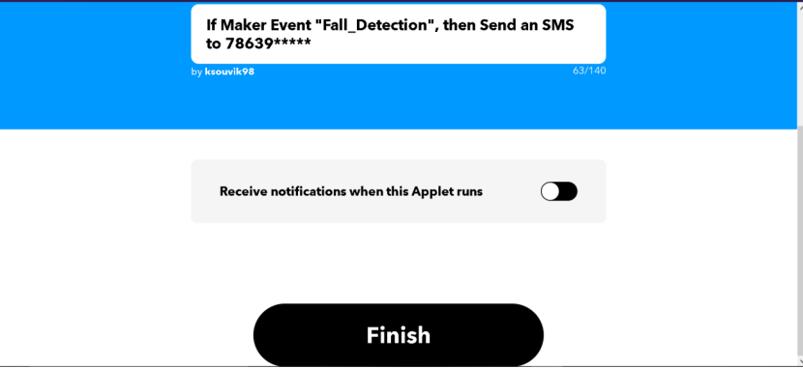
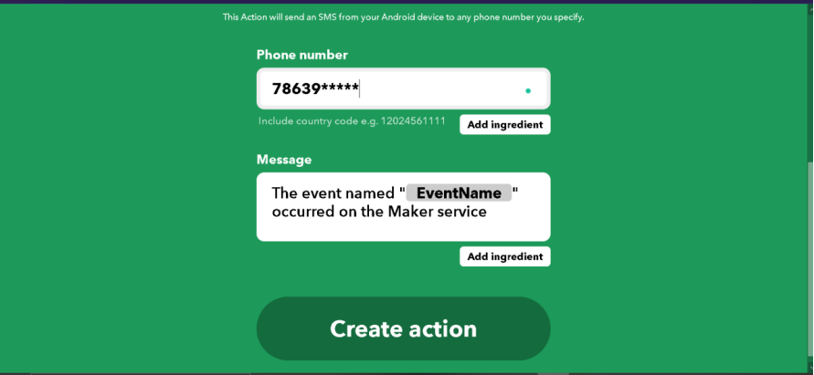
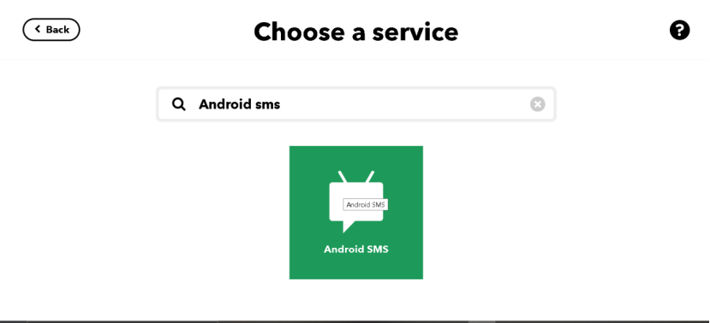
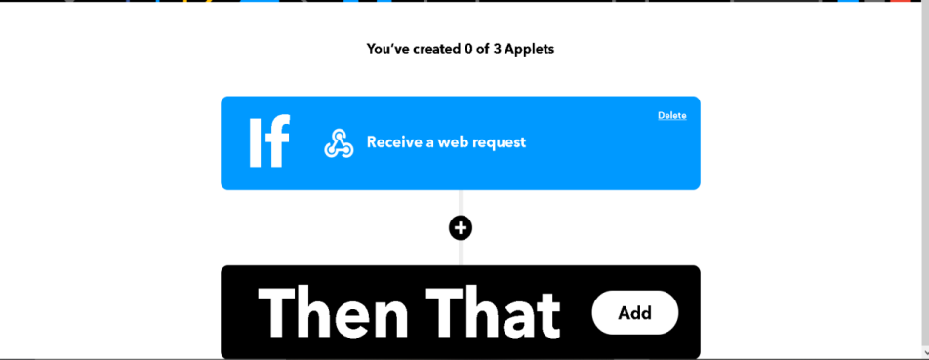
IFTTT SETUP FOR IOT FALL DETECTOR
IFTTT (If This Then That) is a web-based service by which we can create chains of conditional statements, called applets. Using these applets, we can send Emails, posts to Twitter, posts to Facebook, play music, SMS, notifications, etc. Here in this project, we are using IFTTT to send SMS notifications to the mobile phone when the system detects a fall.

Slide 11
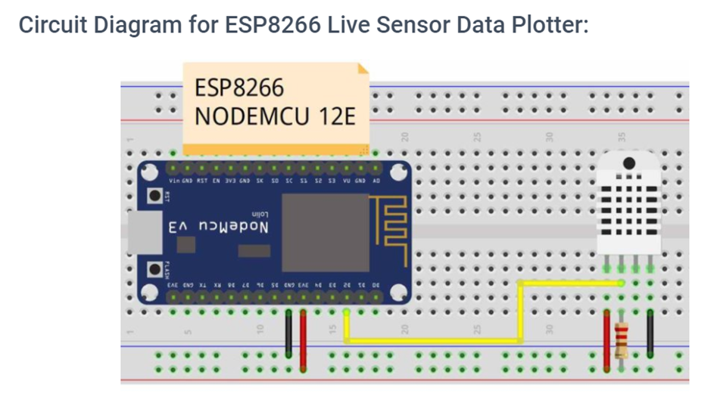
Now that we have collected the sensor data,we plan to display it on a webpage - using a dashboard.
To build the dashboard,we need to plot the data from the sensor at regular intervals,which we plan to accomplish by using ESP8266 wifi module,in the following way -

Slide 12
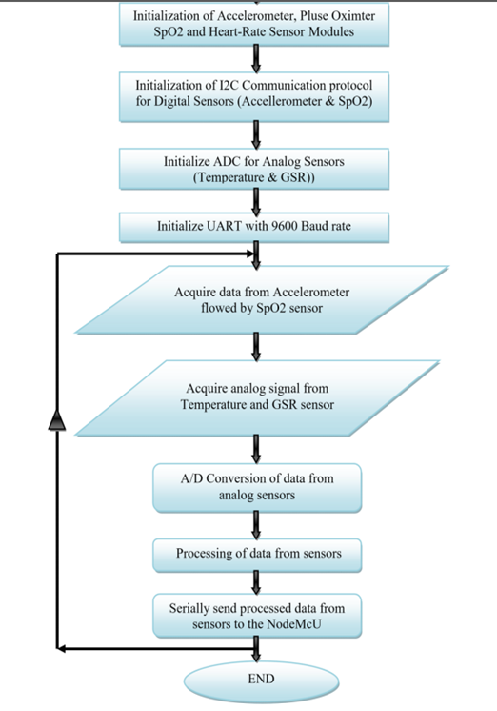
Now that we have collected the sensor data,we plan to display it on a webpage - on a dashboard.
To build the dashboard,we need to plot the data from the sensors at regular intervals,which we plan to accomplish by using ESP8266 wifi module,in the following way -

Slide 13
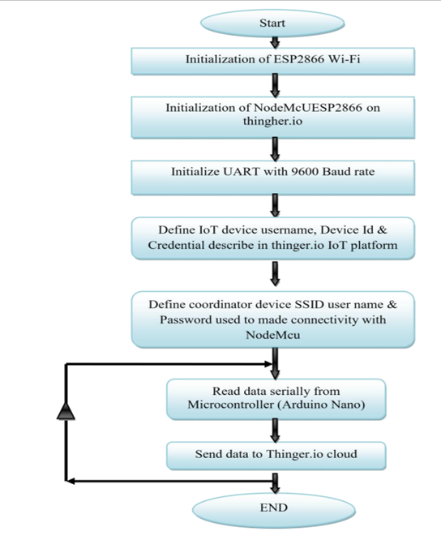
After obtaining the data through the wifi module,this is the flow of control how the data will be displayed on the dashboard,which we build using thinger.io, an open source cloud IOT platform,in this way -

Slide 14
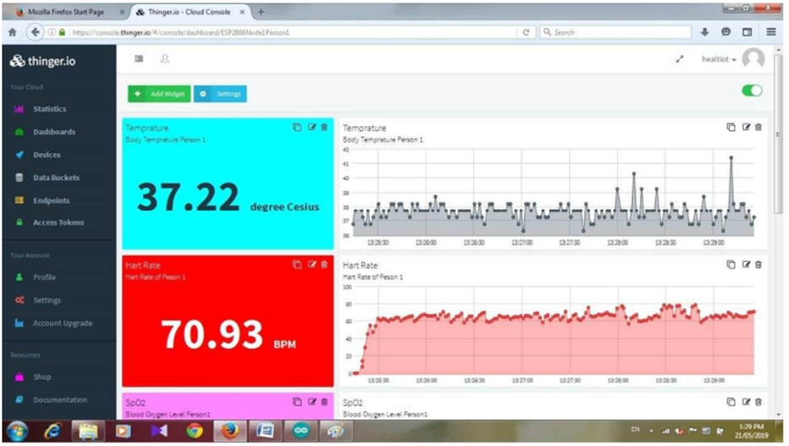
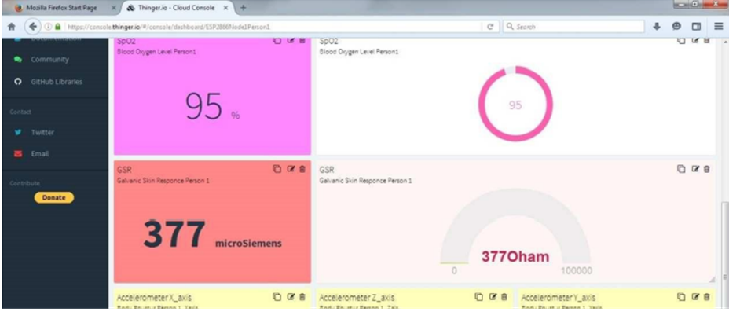
Various dashboards that can be created using the platform
The project also involves the usage of mobile phones to monitor patient parameters,which we do by the blynk app as shown in the next slide

Slide 15
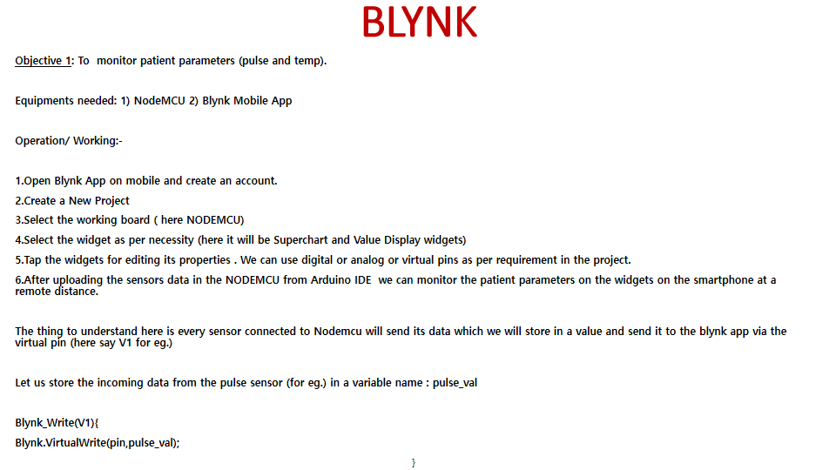

Slide 16
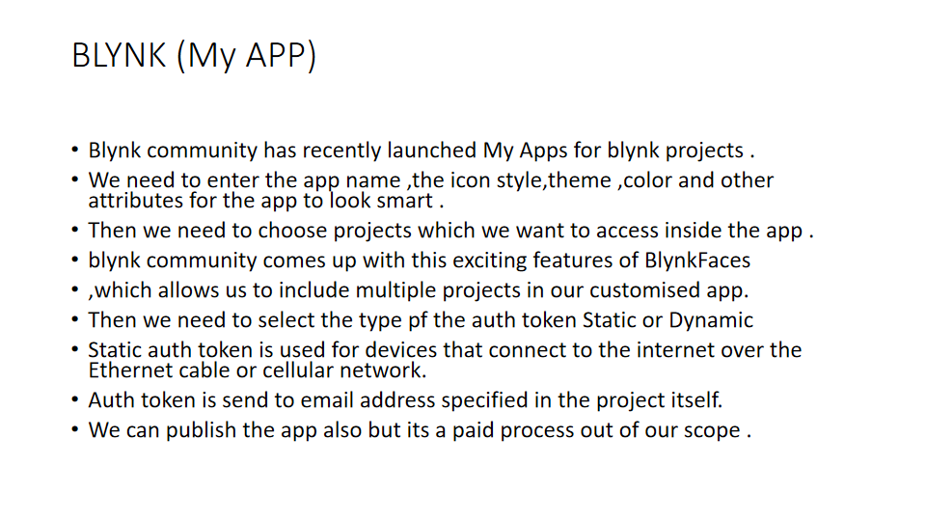

Slide 17
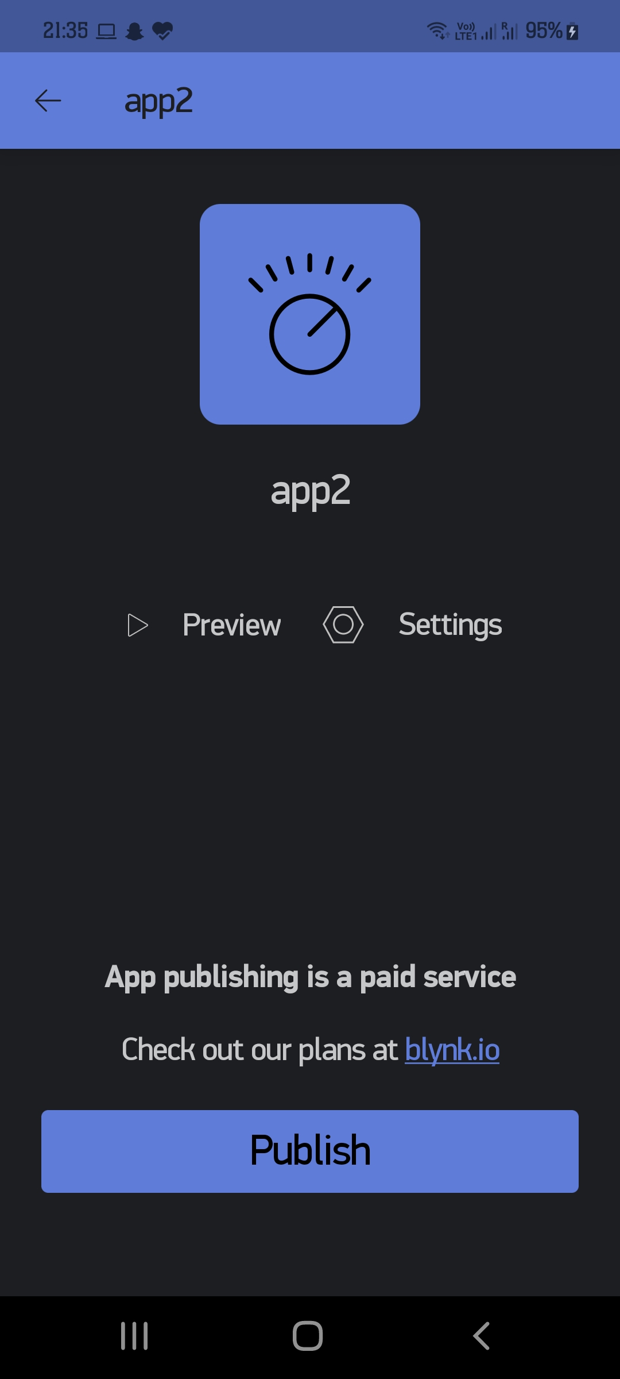
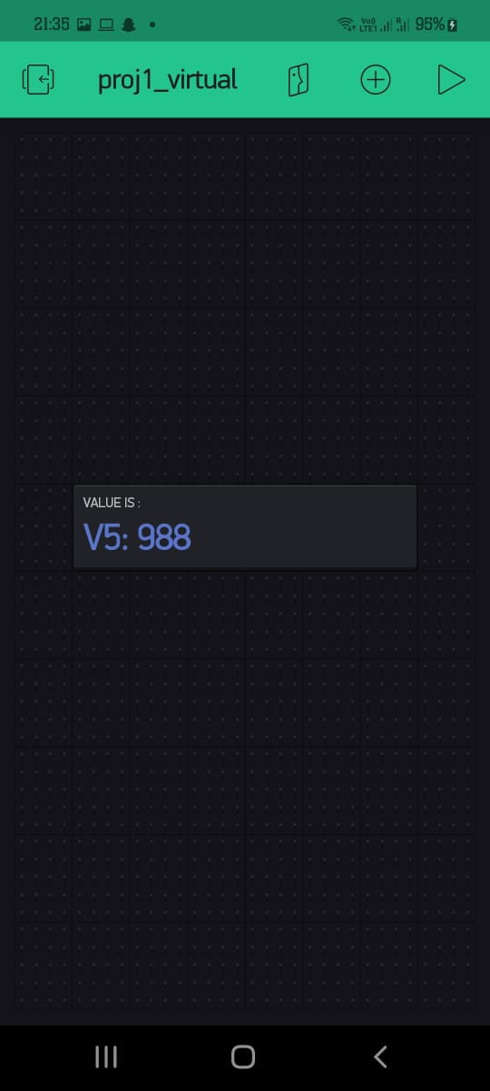

Slide 18
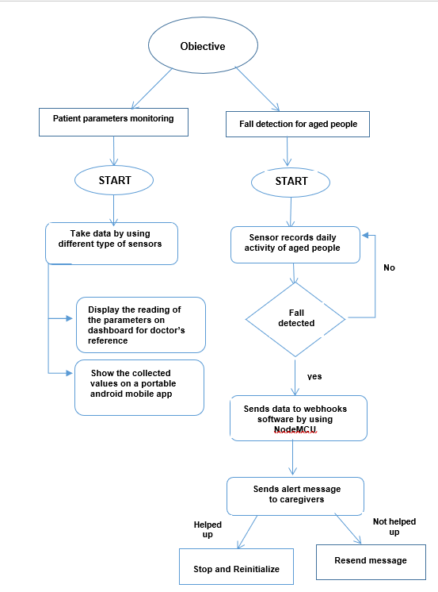
Overall Flow diagram
Overall Flow diagram of the project

Slide 19
References
[1]. Md. Milon Islam, Ashikur Rahaman and Md. Rashedul Islam. 2020. Development of Smart Healthcare Monitoring System in IOT Environment Springer Nature Singapore Pte Ltd.
[2]. Deepak N, Rajendra Prasad C H and Sanjay Kumar Ch. 2018. Patient Health Monitoring using IOT International Journal of Innovative Technology and Exploring Engineering 8.
[3]. Hari Kishore K, Surendra Nath K V, Hari Krishna K V N, Pavan Kumar D, Manikanta V and Fazal Noor Basha. 2019. IOT Based Smart Health Monitoring Alert Device International Journal of Innovative Technology and Exploring Engineering 8.
[4]. Tamilselvi V, Sribalaji S, Vigneshwaran P, Vinu P, GeethaRamani J. IoT based health monitoring system. In: 2020 6th International conference on advanced computing and communication systems (ICACCS). IEEE; 2020. p. 386–9
[5]. Riazul Islam SM, Kwak Daehan, Humaun Kabir M, Hossain M, Kwak Kyung-Sup. The Internet of Things for health care: a comprehensive survey. IEEE Access. 2015;3:678–708.
[6]. Prakash H Patil, Pratyush Singh, Swatee Biradar and Prasad Rane. 2013. Design and Implementation of Wireless Patient Health Monitoring System International Journal of Engineering Research and Technology 2 (6).
[7]. Rahaman A, Islam M, Islam M, Sadi M, Nooruddin S. Developing IoT based smart health monitoring systems: a review. Rev Intell Artif. 2019;33:435–440. doi: 10.18280/ria.330605.
[8]. Islam M S, Islam M T, Ali F. Almutairi, GankokBeng, Amid N M N. 2019. Monitoring of the Human Body Signal through the Internet of Things (IoT) Based LoRa Wireless Network System Journal of Applied Sciences 9
[9]. Desai MR, Toravi S. A smart sensor interface for smart homes and heart beat monitoring using WSN in IoT environment. In: 2017 International conference on current trends in computer, electrical, electronics and communication (CTCEEC). IEEE; 2017. p. 74–7

